Slide 1
HOTEL MANAGEMENT SYSTEM
Submitted by:
Name : Rekha C
Batch No : 6258
Branch : Banglore

Slide 2
INTRODUCTION
This is a Hotel Management tool which can be used to manage activities like storing customer details, booking rooms of four different types, ordering food for particular rooms, unbooking rooms and showing the bill. It can also be used to see different room features and room availability.
It is a menu driven program and it runs until the user exits.

Slide 3
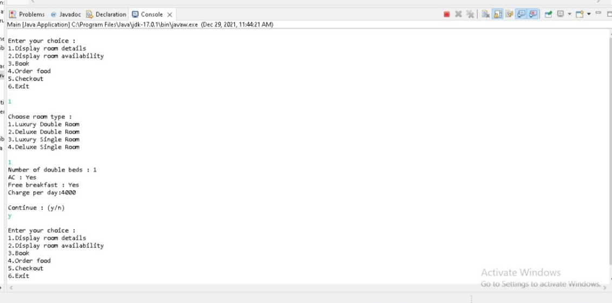
OUTPUT

Slide 4
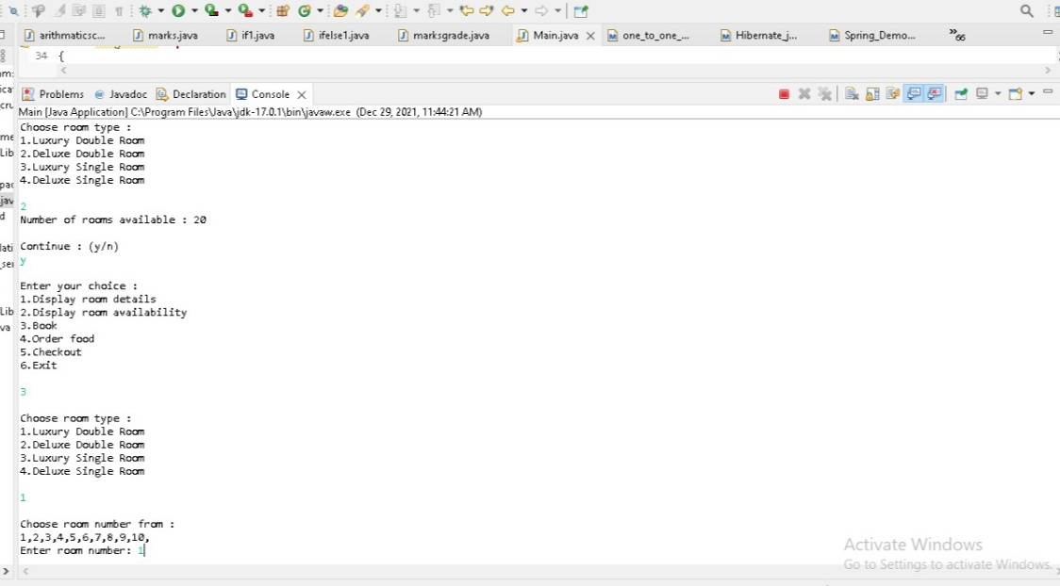

Slide 5
THANK YOU

